Slide 1
Cyber Guru Enterprise
Onboarding Procedure
How to turn employees and contractors into your organization’s first line of defense
www.cyberguru.io

Slide 2
CG Awareness Overview
Awareness
Phishing
Password
Social media
Privacy & GDPR
Mobile Device & APP
Fake News
USB Device
Email Security
Malware & Ransomware
Web Browsing
Critical Scenarios
Social Engineering
Clean Desk
Smart working
Social collaboration e video conferencing
Smishing & Vishing
Spear Phishing
Ransomware
Multi-factor authentication
IoT Device
Bluetooth & WIFI
Information Classification
Data Protection
Social Engineering 2
Real Scam
Phone Scam
Social & Cyberbullying
Privacy
Legal Aspect
Physical Security
E-commerce
Holiday & Business trip
Cyber Hygiene
Backup & Restore
Best practice
Social Engineering 3
UPON COMPLETION OF THE 3 LEVELS
CAMPUS
Knowledge updating
CGA level 1
1st year
CGA level 2
2nd year
CGA level 3
3rd year
Certificate
Campus

Slide 3
CG Awareness Overview - School
Awareness
Breakdown of individual years
12 MODULES
36 LESSONS
The standard release of modules is: one module per month over the course of a year; the module is available in both video and pdf format
Each module consists of 3 lessons lasting from 5-7 minutes each
36 LEARNING TESTS
4 REINFORCEMENT TESTS
After each lesson there is a test, 3 out of 4 questions must be answered correctly in order to access the next lesson, tests can be repeated
For every 3 modules there is a reinforcement test, 10 out of 10 questions must be answered correctly, tests cannot be repeated; a negative result does not block access to the next module
1 COURSE CERTIFICATE
Upon completion of the modules for each year, the user can download the certificate
Gamification
Medals are obtained by passing the learning tests at the end of the lesson
<4 correct answers out of 4>
Cups are obtained by passing the reinforcement test after every 3 modules
< 10 correct answers out of 10>
Extra content in the platform:
Micro-pills (video)
Special sections:
Internal Area

Slide 4
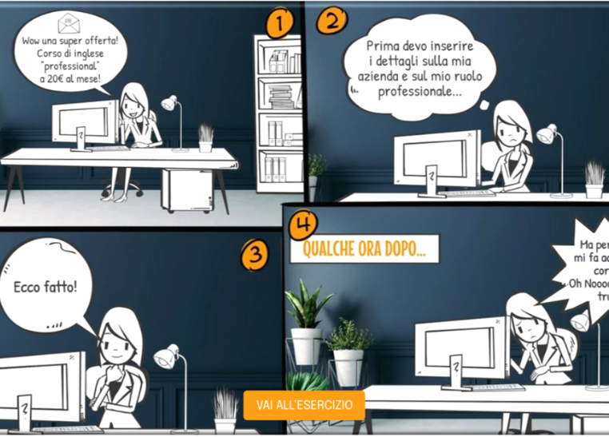
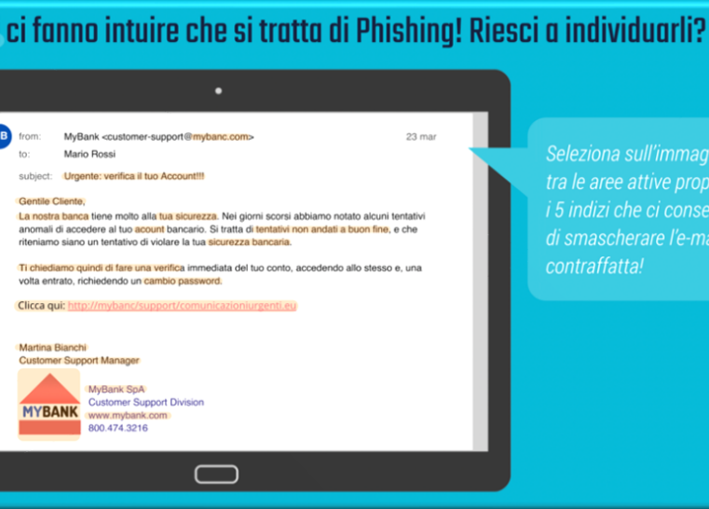
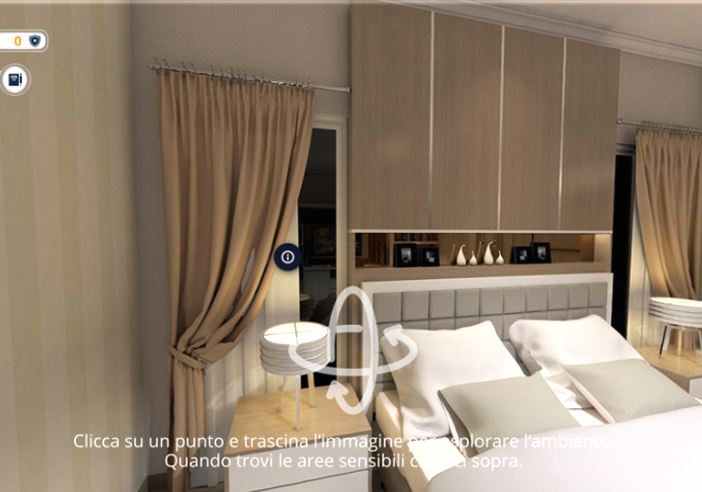
Campus - Maintenance & Update
Awareness
Lifelong Learning
Warm-Up
DidActive
Serious Game
Cyber Insights
MAINTENANCE
UPDATING

Slide 5
Overview CG Awareness - Campus
Awareness
Context
Clean & Secure
E-Commerce
Cyber Hygiene
Backup
Travel
Mobile
Email Investigate
Phishing rcap
Malware recap
Email Investigate
Personal data
Ramsonware
Password Recap
Social Media
Social Engineering
Difficult travelling
Kalasya conspiracy
Cyber «Risk it all»
The art of deception
SMS Spoofing
Password Manager
Juice Jacking
Keylogger
Unconscious Testimonial (AI)
Deep Fake (AI)
Privacy Risk (AI)
Targeted Attacks (AI)
WARM UP
DIDACTIVE
SERIOUS GAME
CYBER INSIGHTS

Slide 6
Overview CG Awareness - Campus
Awareness
Breakdown of individual years
8 WARM UP
8 DIDACTIVE
Learning situational objects that include 5 interactions for each of which feedback and 'shields' are obtained for the following conditions: correct interaction, partially correct, or incorrect.
Educational learning objects that include 5 interactions, for each of which feedback and 'shields' are obtained for the following conditions: correct interaction, partially correct, or incorrect
8 CYBER INSIGHTS
4 SERIOUS GAMES
Dedicated update sessions on a single topic, consisting of a video clip and a four-question test.
Every 3 contents, an interactive 'serious game' is introduced that employs the technique of 'game-based learning' to develop understanding regarding Cybersecurity topics.
1 COURSE CERTIFICATE
Upon completion of the modules for each year, the user can download the certificate
Gamification
The medal will be obtained by excellently surpassing all interactions.
Extra contents in the platform:
Micro-pills (video)
Special session:
Internal Area

Slide 7
CG Channel Overview
Channel
CGC Episodes
CEO FRAUD – From heaven to hell in one click
SMART WORKING – The perfect storm
PASSWORD – It’s just a game!
USB DEVICE – A fistful of songs
PUBLIC WIFI – Caught in the net
SOCIAL ENGINEERING – The worst deal ever
DEEPFAKE – Scammers work in mysterious ways
RANSOMWARE – Learn how to read!
SIM SWAP – The unbearable lightness of bank accounts
IDENTITY THEFT – Don’t let hackers get in your shoes
SCAM WEBSITES – The crocodile technique
SMISHING – Fatal Refund
WATERING HOLE – All mad for the discount
WHATSAPP SCAMS – A fruitful fishing
VISHING & DATA THEFT – Call me
QISHING - “Dangerous” parking
FAKE WEBSITE – Try, but don’t forget
CEO FRAUD – Copy with too much knowledge
DATA PROTECTION – A memorable photo…to forget
SPEAR PHISHING – It all started with an e-mail
FAKE NEWS – Beyond Appearances
PHARMING - A “wrong” donation
PRIVACY – Dangerous Posts
SHARED DEVICES – A "no low cost" holiday
CEO FRAUD – Thin connections
CREDENTIAL STUFFING – An inconvenient truth
PASSWORD SECURITY – No alternative
EMAIL SPOOFING – Domino effect
SPEAR PHISHING – The devil is in the details
PRIVACY – An incriminating selfie
SIM SWAP – The cat and the fox 2.0
WATERING HOLE – The lion and the gazelle
PUBLIC WIFI – The fish in the net
USB DEVICE – Lethal USB stick
KEYLOGGER – Key logger (an invisible enemy)
CYBERSECURITY – The culprit
CGC level 1 – 1st Season
CGC level 2 – 2nd Season
CGC livello 3 – 3rd Season

Slide 8
CG Channel Overview
Channel
Breakdown of individual year
12 EPISODES
STORYTELLING
The standard release of Channel episodes is:
one episode each month over the course of a year; once they are released, the episodes will remain visible on the platform.
The episodes are characterized by a captivating storytelling, which capitivates the users, giving them an immersive experience of the content in the video, similar to a TV series.
DURATION OF EPISODES
ACCESS TO CHANNEL
The duration of the individual episodes is limited and follows the same approach as the duration of the video lessons in the Awareness Program; on average, the episodes last about 5 minutes each.
Access is enabled using the same platform interface as the Awareness Program

Slide 9
Onboarding Process
Contractual Aspects
SERVICE ACTIVATION
LICENSE VALIDITY
ACCEPTANCE OF T&C
KNOWLEDGE BASE DOCUMENTATION
The contact person will receive credentials for a first-time login on the Cyber Guru onboarding portal
Licenses are valid from the day of service activation until the contract expires
Access to onboarding portal and acceptance of T&C
EULA
Appointment of data controller
Privacy policy
It will be possible to access and download process and product documentation, upload logos and the user list required for GO LIVE, within the shared repository

Slide 10
Onboarding Process
Operational Aspects
USER LIST
CUSTOMIZATION
High resolution logo
WHITELISTING
Technical test
PROGRAM ANNOUNCEMENT
Internal communication
GO LIVE
List of users that will be accessing the service
Customization of the platform with the Client’s logo
Assess the full usability of the platform
Communication plan for initiating and maintaining participation
GO LIVE of the program and start of training
CLIENT
CLIENT
CLIENT
CLIENT
CYBER GURU
OWNER
CYBER GURU SUPPORT
USER LIST
LISTA UTENTI

Slide 11
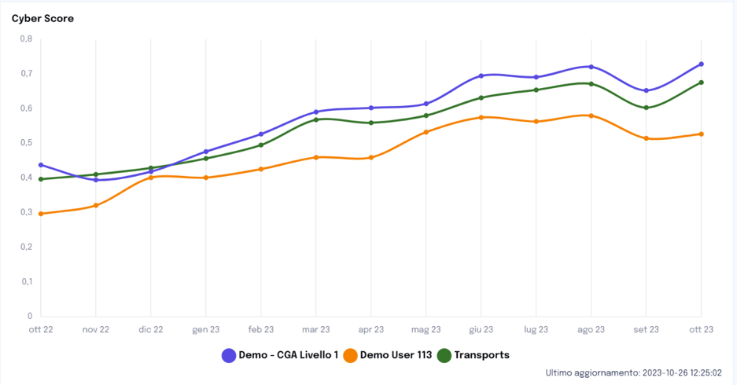
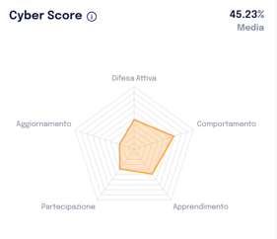
Gamification
TEAM-BASED GAMIFICATION
(Strongly recommended)
INDIVIDUAL GAMIFICATION
User Engagement
Reward
Achievement
Motivation
Learning
Challenge

Slide 12
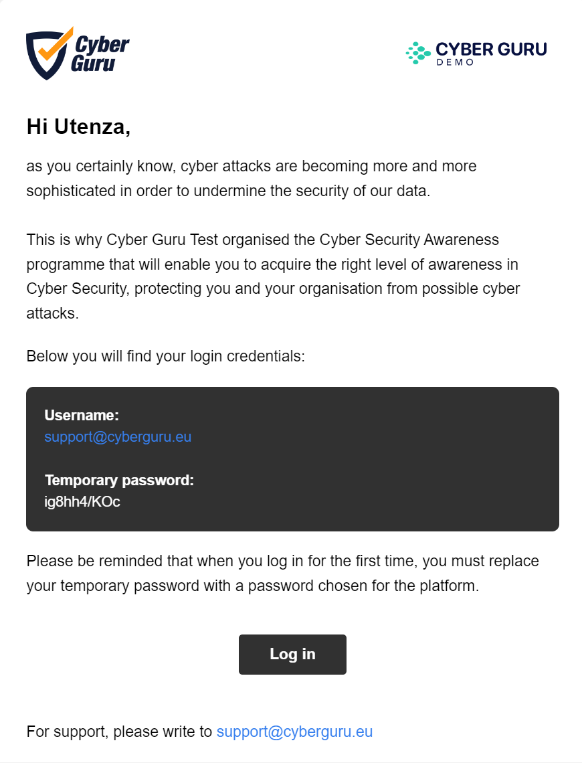
Student Caring
Internal communication by the Client
Notification of GO LIVE (after internal comunication)
Notification for the release of a new module
Sending massive emails from team leader and/or supervisor directly from the platform (e.g., reminders)
Notes:
Solo la comunicazione interna viene gestita dal cliente. Le altre sono automatiche dalla piattaforma

Slide 13
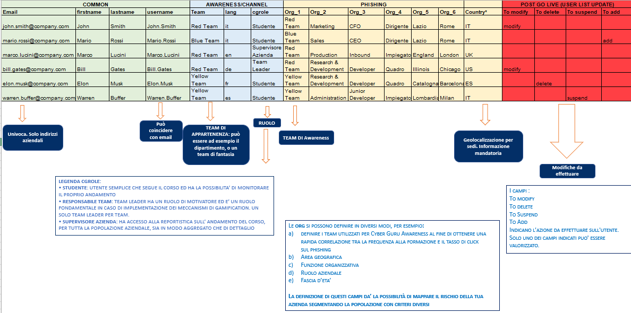
User List Template
Unique. Only company emails
Can coincide with email
Team membership: can be, for example, the department or an invented team
Role
Awareness team
Geolocation for locations. Mandatory information
Changes to be made
CGRole Key:
STUDENTE: Simple user who takes the course and has the possibilty to monitor their own progress.
RESPONSABILE TEAM: Team leader has the role of a motivator and is a key role when implementing gamification. Only one team leader per team.
SUPERVISORE AZIENDA: Company supervisor has access to course progress reporting for the entire company population, both in aggregate and in detail.
FIELDS:
TO MODIFY
TO DELETE
TO SUSPEND
TO ADD
These indicate the action to be carried out for the user. Only one of these fields can be indicated.
THE ORG CAN BE DEFINED IN DIFFERENT WAYS, FOR EXAMPLE:
Define the teams used for Cyber Guru Awareness in order to have a quick correlation between training attendance and the phishing click rate
Geographical area
Organizational function
Corporate role
Age group
DEFINING THESE FIELDS GIVES YOU THE POSSIBILITY TO MAP YOUR COMPANY’S RISK BY SEGMENTING THE POPULATION USING DIFFERENT CRITERIA

Slide 14
Master Plan
13 MONTHS
ONBOARDING
TRAINING ACCESS
LEVEL 1
SERVICE ACTIVATION EMAIL
END OF SERVICE
1 MONTH
GO LIVE
12 MONTHS
Service is active from the date of service activation notice (irrespective of Go Live).
Onboarding is recommended within a month of service activation in order to maintain an adequate cognitive load and effective learning. Delays in the Go Live require a planning of releases which may have an impact on the effectiveness of the training path.

Slide 15
OnBoarding: checklist
1 MONTH
ACTIVATION
KICK-OFF PREP
LOGOS & CUST.
USER LIST & WHITE LIST
PLATFORM TEST
COMMUNICATION
SERVICE ACTIVATION
ACCEPTANCE OF T&C
KICK-OFF
USER LIST & WL
READY TO GO
GO LIVE
CHECK LIST
Contact person during onboarding, access to the document repository and follow up
Gamification (strongly reccomended)
Names for supervisor access to the platform
Monitored video with blocked progress bar
Detailed statistics with names
Ranking closure (by level/year or at the end of all years)
Client subdomain for creation of dedicated tenant
Go Live date
Required languages
Schedule releases within the license expiration date

Slide 16
OnBoarding: checklist
1 MONTH
ACTIVATION
KICK-OFF PREP
LOGOS & CUST.
USER LIST & WHITE LIST
PLATFORM TEST
COMMUNICATION
SERVICE ACTIVATION
ACCEPTANCE OF T&C
KICK-OFF
USER LIST & WL
READY TO GO
GO LIVE
SETTINGS & TESTING
CLIENT TASKS
CYBER GURU TASKS
Provide logos
Provide Whitelist Doc (Repository)
Whitelisting Configuration
Provide User List Template (Repository)
Provide User List (Max 5 days before Go Live)
Dedicated Tenant Settings
Platform testing support
Platform testing

Slide 17
OnBoarding: GO LIVE
1 MONTH
ACTIVATION
KICK-OFF PREP
LOGOS & CUST.
USER LIST & WHITE LIST
PLATFORM TEST
COMMUNICATION
SERVICE ACTIVATION
ACCEPTANCE OF T&C
KICK-OFF
USER LIST & WL
READY TO GO
GO LIVE
COMMUNICATION & GO LIVE
CLIENT TASKS
CYBER GURU TASKS
Internal communication for program launch
Upload User List to platform
Go Live

Slide 18
Training Access
12 MONTHS
TRAINING ACCESS
LEVEL 1
GO LIVE
END OF SERVICE
HELP DESK FOR USERS
REPORTING
support@cyberguru.eu
Reporting is standard pursuant to platform
USER LIST UPDATES
FOLLOW UP
To be provided in standard format within 5 working days before Go Live
Follow up meeting
GO LIVE
Go Live dates and subsequent releases must be scheduled at least 5 business days in advance of date

Slide 19
Cyber Guru Phishing
Onboarding Procedure
How to turn employees and contractors into your organization’s first line of defense
www.cyberguru.io

Slide 20
CG Phishing Overview
Phishing
Breakdown of year
12 CAMPAIGNS
3-4 WEEKS
Each campaign consists of 10 templates; with the first 3 campaigns, the A.I. engine studies the behavior of the individual recipient to calibrate the level of subsequent mailings.
The standard duration of a single campaign is 3-4 weeks.
SENDING CAMPAIGN
DASHBOARD & ANALYTICS
Template sending is random by time of sending, type of template sent and users affected.
The Dashboard available on the platform highlights the progress of campaigns, the distribution of weak/strong users for each campaign and numerous other metrics.
REMEDIATION
Based on what statistics reveal, one can decide to launch a campaign aimed at a cluster of users in order to reinforce the level of resistance to attacks. We reccomend a few remediations after 7/8 campaigns.
Types of users:
Weak user:
These are users that tend to regularly open emails and click on links.
Strong user:
These are the users that tend to open emails but not click on links.
Defender:
These are users that, not only do not fall for the phishing attacks, but also report them following the set procedure.

Slide 21
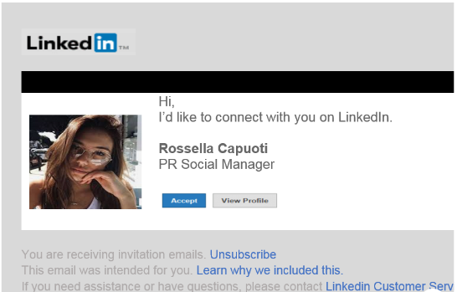
CG Phishing Overview
Phishing
Clicking on the link in the phishing email will take the user to a landing page with information on phishing hints that the user should have noticed and an educational video.

Slide 22
Onboarding Process
Phishing
Operational Aspects
USER LIST
CUSTOMIZATION
High resolution logo
WHITELISTING
Technical test
CAMPAIGN
APPROVAL
PROGRAM STARTUP
Go Live
List of users that will be accessing the service
Customization of the platform with the Client’s logo
Avoid being filtered by security/spam rules
Technical testing from platform
The first 3 campaigns are automatically approved (baseline cycle).
Approval is repeated in every campaign
GO LIVE of the program and start of training
CLIENT
CLIENT
CLIENT
CLIENT
CYBER GURU
OWNER
CYBER GURU SUPPORT
USER LIST
LISTA UTENTI

Slide 23
User List Template
Unique. Only company emails
Can coincide with email
Team membership: can be, for example, the department or an invented team
Role
Awareness team
Geolocation for locations. Mandatory information
Changes to be made
CGRole Key:
STUDENTE: Simple user who takes the course and has the possibilty to monitor their own progress.
RESPONSABILE TEAM: Team leader has the role of a motivator and is a key role when implementing gamification. Only one team leader per team.
SUPERVISORE AZIENDA: Company supervisor has access to course progress reporting for the entire company population, both in aggregate and in detail.
FIELDS:
TO MODIFY
TO DELETE
TO SUSPEND
TO ADD
These indicate the action to be carried out for the user. Only one of these fields can be indicated.
THE ORG CAN BE DEFINED IN DIFFERENT WAYS, FOR EXAMPLE:
Define the teams used for Cyber Guru Awareness in order to have a quick correlation between training attendance and the phishing click rate
Geographical area
Organizational function
Corporate role
Age group
DEFINING THESE FIELDS GIVES YOU THE POSSIBILITY TO MAP YOUR COMPANY’S RISK BY SEGMENTING THE POPULATION USING DIFFERENT CRITERIA

Slide 24
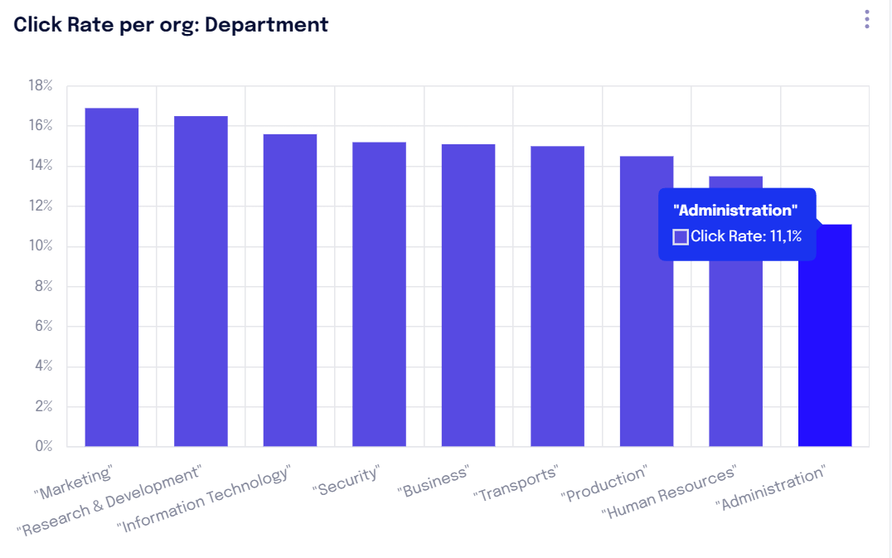
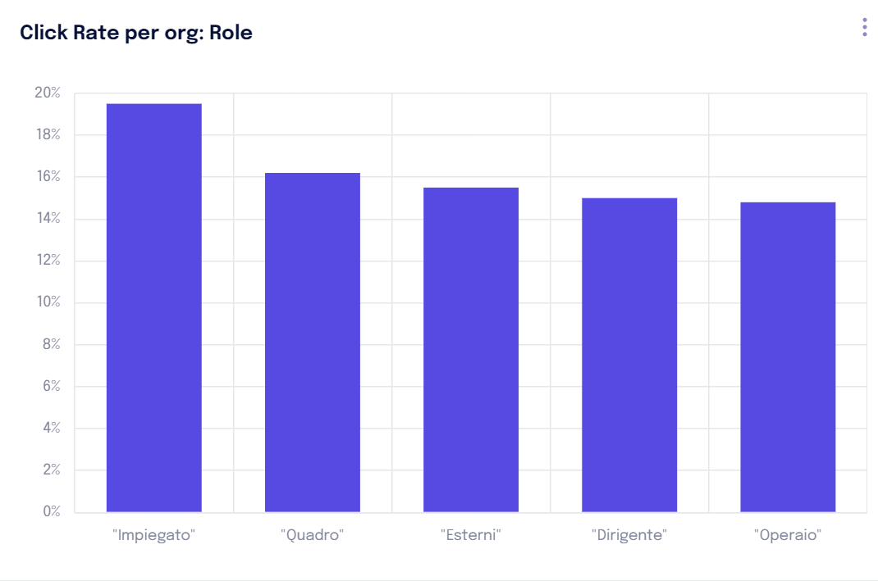
Mapping business risks by Org
Phishing
COMMON |  |  |  | AWARENESS/CHANNEL |  |  | PHISHING |  |  |  |  |  |  | POST GO LIVE (USER LIST UPDATE)
Email | firstname | lastname | username | Team | lang | cgrole | Org_1 | Org_2 | Org_3 | Org_4 | Org_5 | Org_6 | COUNTRY* | To modify | To delete | To suspend | To add
John.Smith@company.com | John | Smith | John.Smith | Red Team | it | Studente | Red Team | Marketing | CFO | Dirigente | Lazio | Rome | IT | modify
Mario.rossi@company.com | Mario | Rossi | Mario.Rossi | Blue Team | it | Studente | Blue Team | Sales | CEO | Dirigente | Lazio | Rome | IT |  |  |  | add
Marco.lucini@company.com | Marco | Lucini | Marco.Lucini | Red Team | en | Supervisore Azienda | Red Team | Production | Inbound | Impiegato | England | London | UK
Bill.Gates@company.com | Bill | Gates | Bill.Gates | Red Team | de | Team Leader | Red Team | Research & Development | Developer | Quadro | Illinois | Chicago | US | modify
Elon.Musk@company.com | Elon | Musk | Elon.Musk | Yellow Team | fr | Studente | Yellow Team | Research & Development | Developer | Quadro | Catalogna | Barcelona | ES |  | delete
Warren.buffer@company.com | Warren | Buffer | Warren.Buffer | Yellow Team | es | Studente | Yellow Team | Administration | Junior Developer | Impiegato | Lombardia | Milan | IT |  |  | suspend

Slide 25
Master Plan
Phishing
13 MONTHS
ONBOARDING
TRAINING ACCESS
LEVEL 1
SERVICE ACTIVATION EMAIL
END OF SERVICE
1 MONTH
GO LIVE
12 MONTHS
Service is active from the date of service activation notice (irrespective of Go Live).
Onboarding is recommended within a month of service activation in order to maintain an adequate cognitive load and effective learning.

Slide 26
OnBoarding: checklist
1 MONTH
ACTIVATION
KICK-OFF PREP
LOGOS & CUST.
USER LIST & WHITE LIST
PLATFORM TEST
COMMUNICATION
SERVICE ACTIVATION
ACCEPTANCE OF T&C
KICK-OFF
USER LIST & WL
READY TO GO
GO LIVE
CHECK LIST
Contact person during onboarding, access to the document repository and follow up
Languages and countries requested
Names for supervisor access to the platform
Go Live date
Detailed statistics with names
Schedule releases within the license expiration date
Client subdomain for creation of dedicated tenant

Slide 27
OnBoarding: settings and testing
1 MONTH
ACTIVATION
KICK-OFF PREP
LOGOS & CUST.
USER LIST & WHITE LIST
PLATFORM TEST
COMMUNICATION
SERVICE ACTIVATION
ACCEPTANCE OF T&C
KICK-OFF
USER LIST & WL
READY TO GO
GO LIVE
SETTINGS & TESTING
CLIENT TASKS
CYBER GURU TASKS
Provide logos
Provide Whitelist Doc (Repository)
Whitelisting Configuration
Provide User List Template (Repository)
Provide User List (Max 5 days before Go Live)
Dedicated Tenant Settings
Platform testing support
Platform testing

Slide 28
OnBoarding: GO LIVE
1 MONTH
ACTIVATION
KICK-OFF PREP
LOGOS & CUST.
USER LIST & WHITE LIST
PLATFORM TEST
COMMUNICATION
SERVICE ACTIVATION
ACCEPTANCE OF T&C
KICK-OFF
USER LIST & WL
READY TO GO
GO LIVE
APPROVAL & GO LIVE
CLIENT TASKS
CYBER GURU TASKS
Approval of Baseline campaigns
Upload User List to platform
Go Live

Slide 29
Delivery of phishing campaign
12 MONTHS
DELIVERY OF PHISHING CAMPAIGN
GO LIVE
END OF SERVICE
HELP DESK FOR USERS
REPORTING
support@cyberguru.eu
Reporting is standard pursuant to platform
USER LIST UPDATES
FOLLOW UP
To be provided within the 15th of the month, lead time updates 10 working days
Follow up meeting
CAMPAIGNS
CAMPAIGN APPROVAL
By default campaigns will be auto-approved to avoid training gaps
Active campaigns cannot be changed after their approval
29

Slide 30
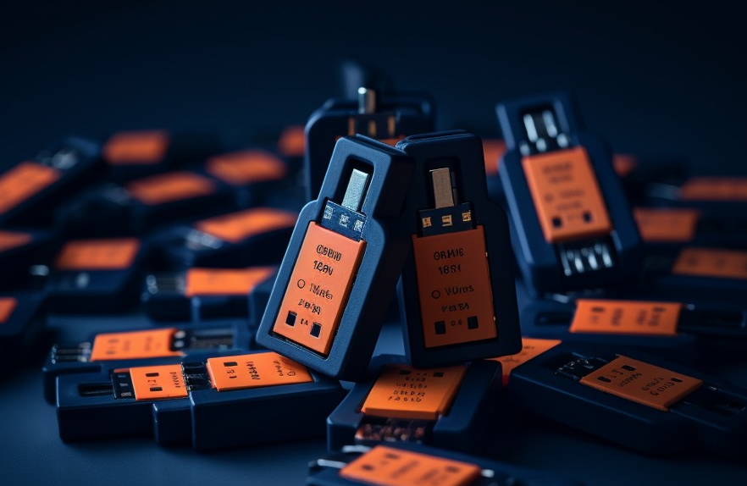
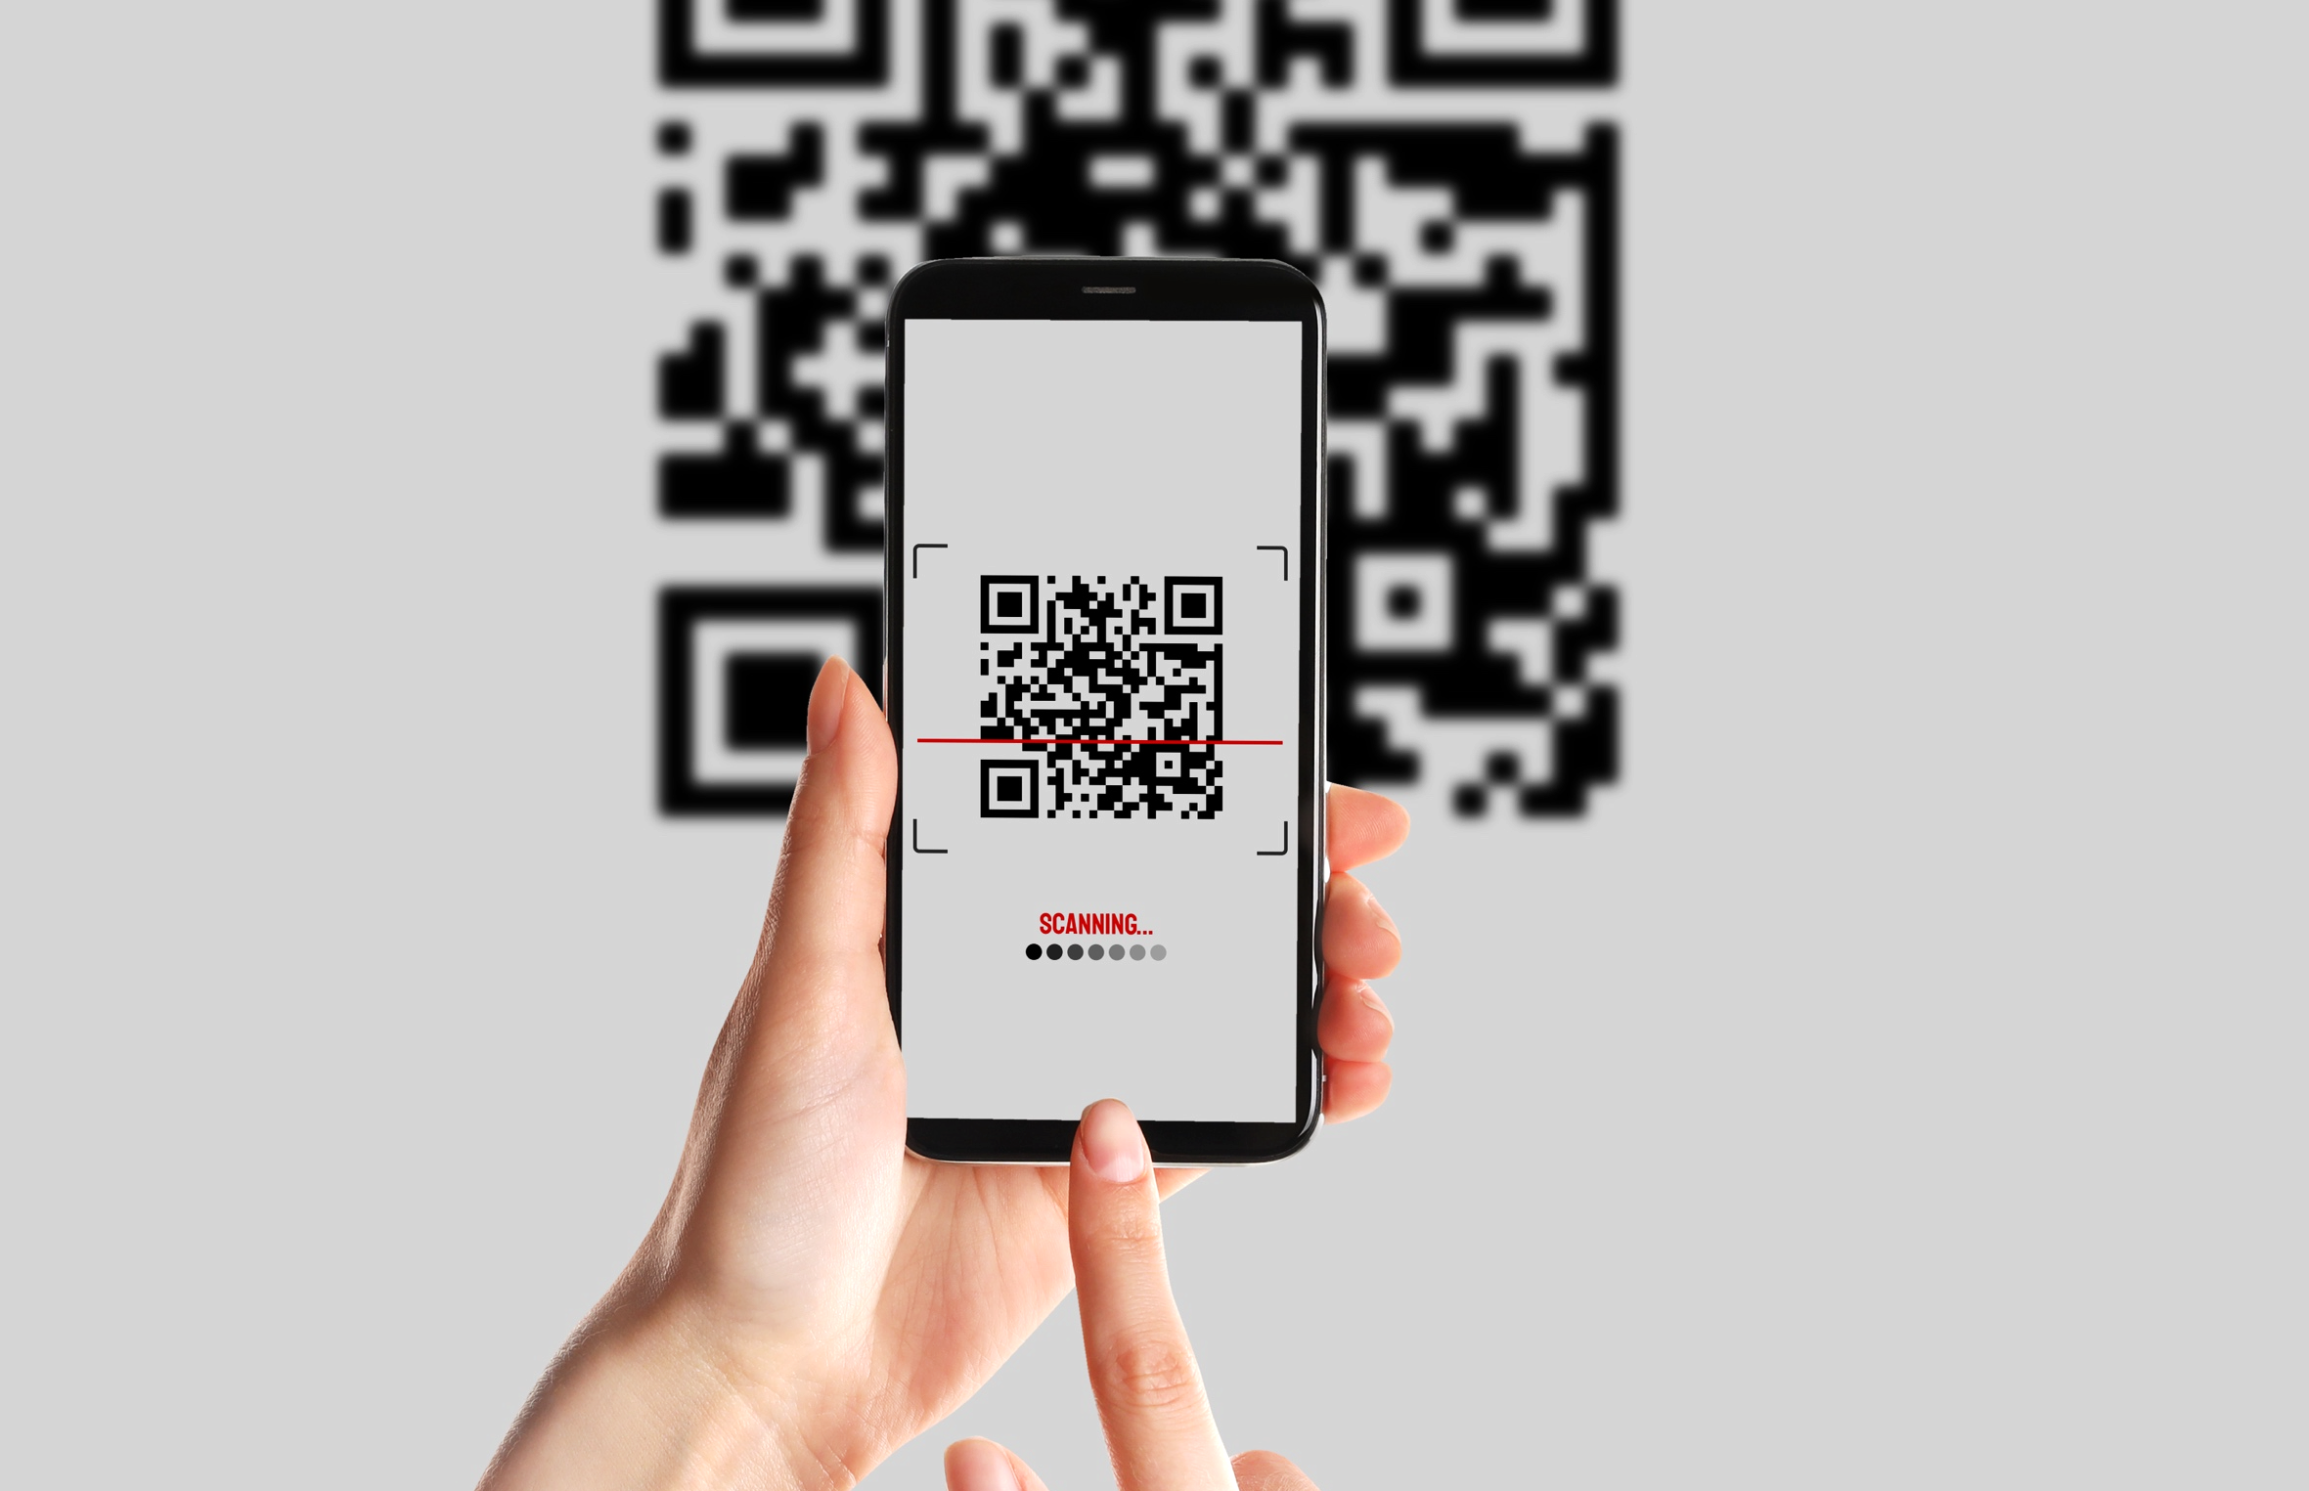
PhishPro
USB ATTACK
QRCODE ATTACK
ADAPTIVE LEARNING REMEDIATION
Carry out simulated phishing attacks through the use of USB flash drives.
Carry out simulated phishing attacks through the use of QR Codes.
Carry out Adaptive Remediation actions: offering users dedicated educational content.
www.cyberguru.io

Slide 31
USB Attack
Phishing
Objective:
Carry out simulated phishing attacks through the use of USB flash drives
Features:
Supervisors will be able to enhance anti-phishing training by creating a USB flash drive containing a "malicious" file
Each time the file is opened, a report will be supplied in the Remediation Dashboard where the number of times the document has been opened will appear.
The execution of the Word macro will trigger the name capture of the Host (it will be recorded that the user not only inserted the USB flash drive into the device, but also agreed to run the macro, thus an additional exposure to cyber risk with a particularly dangerous security action).

Slide 32
Qrcode Attack
Phishing
Objective:
Carry out simulated phishing attacks thtrough the use of QR Codes
Features:
Supervisors will be able to expand anti-phishing trainingby creating "malicious" QR codes.
The QR Codes will be printed and distributed within the organization.
People who scan and agree to open the link in the QR Code will be redirected to a dedicated landing page where they will be asked to provide sensitive information such as their name and email.
Each time a QR Code is scanned, a report will be supplied in the Remediation Dashboard. This report will indicated scans and those who have submitted the additional information requested.

Slide 33
Adaptive Learning Remediation
Phishing
Objective:
Carry out adaptive Remediation actions: providing users in need with dedicated educational content aimed at threat recognition.
Features:
Supervisors will be able to assign content dedicated to the users defined as "weak“ or those who meet similar criteria, from the Remediation Dashboard to provide specific training aimed at recognizing phishing threats.

Slide 34
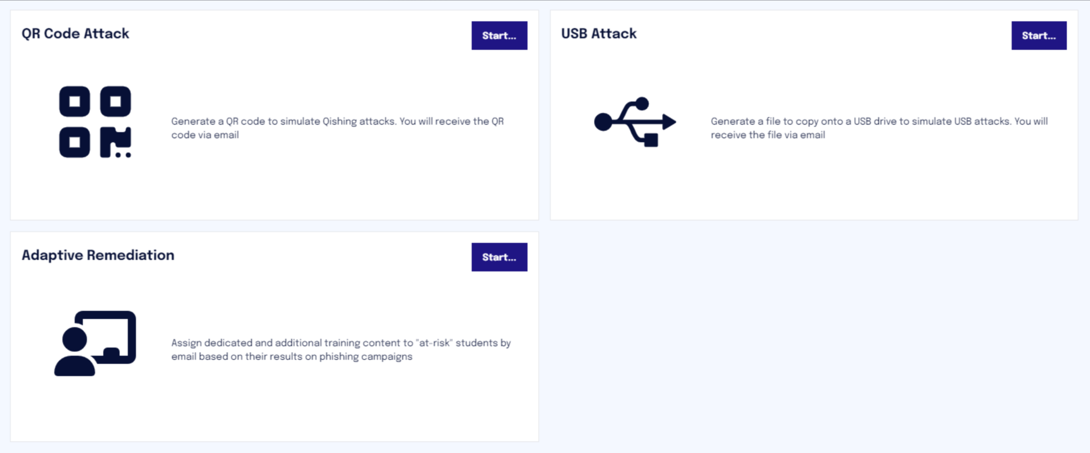
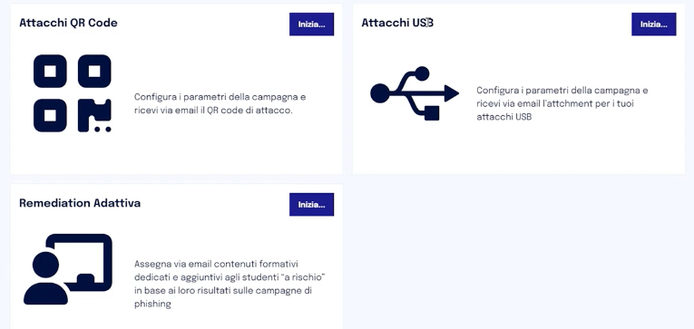
Phishpro OnBoarding
Phishing
Same onboarding as Phishing
PhishPro features come in the form of 3 new “Remediations”

Slide 35
Customer Success Team
What we offer
CST Package
knowledge base
(documentation)
Kick off meeting *
Support to check & upload first user list **
Support for whitelisting settings
Support for internal lauch communication
Training analysis and recommendation - Mid Term SAL*
Onboarding
Product
Technical
Dedicated cst manager
During all service life cycle
helpdesk
During service life cycle
support@cyberguru.eu
* Mandatory activity
** Strongly suggested activity

Slide 36
Customer Success Team
CST Package per purchased licenses
License package
Documentation
Helpdesk
Customer Management Service
Regular reporting on hours balance
SIZE
XS
S
M
L
XL
CST
PACK (H)
8
16
24
48
56
XS Users ≤ 250
S 251 < Users ≤1000
M 1001 < Users ≤ 3000
L 3001 < Users ≤ 10000
XL Users > 10000
LEGENDA

Slide 37
Thank you

